Slide 1
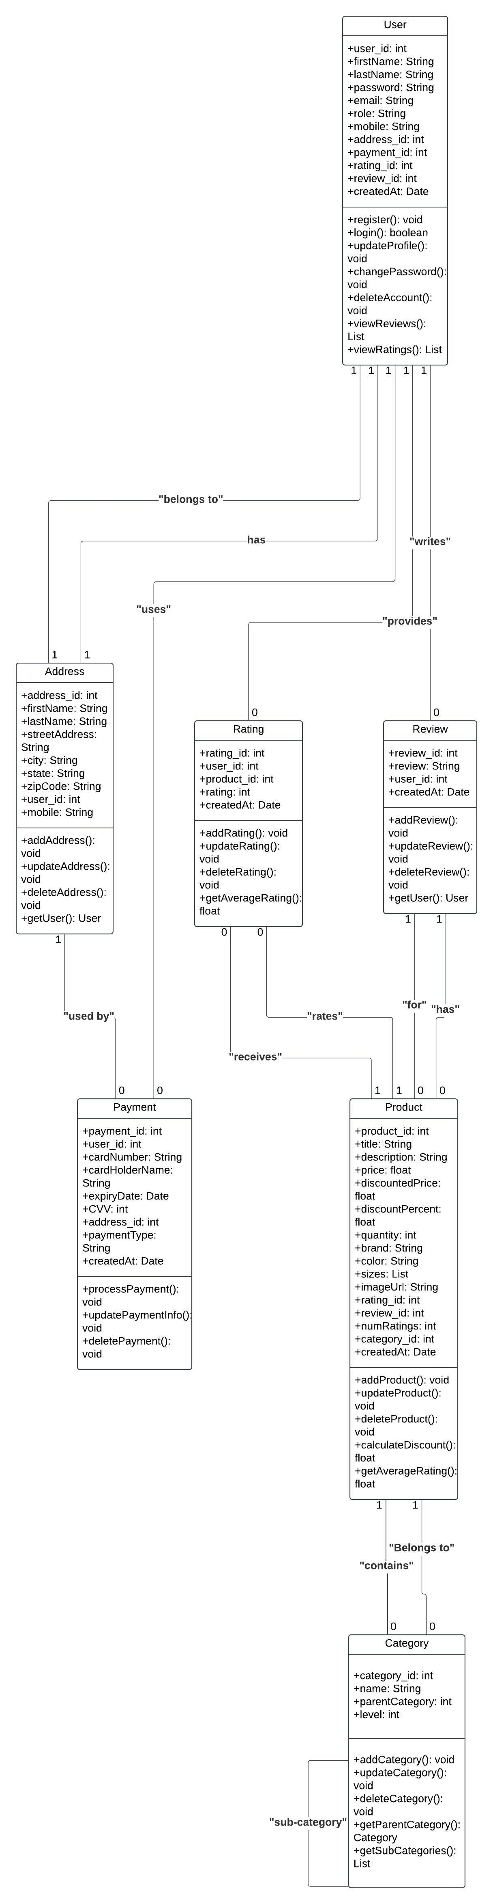
Class Diagram – Stylehive –S2

Slide 2
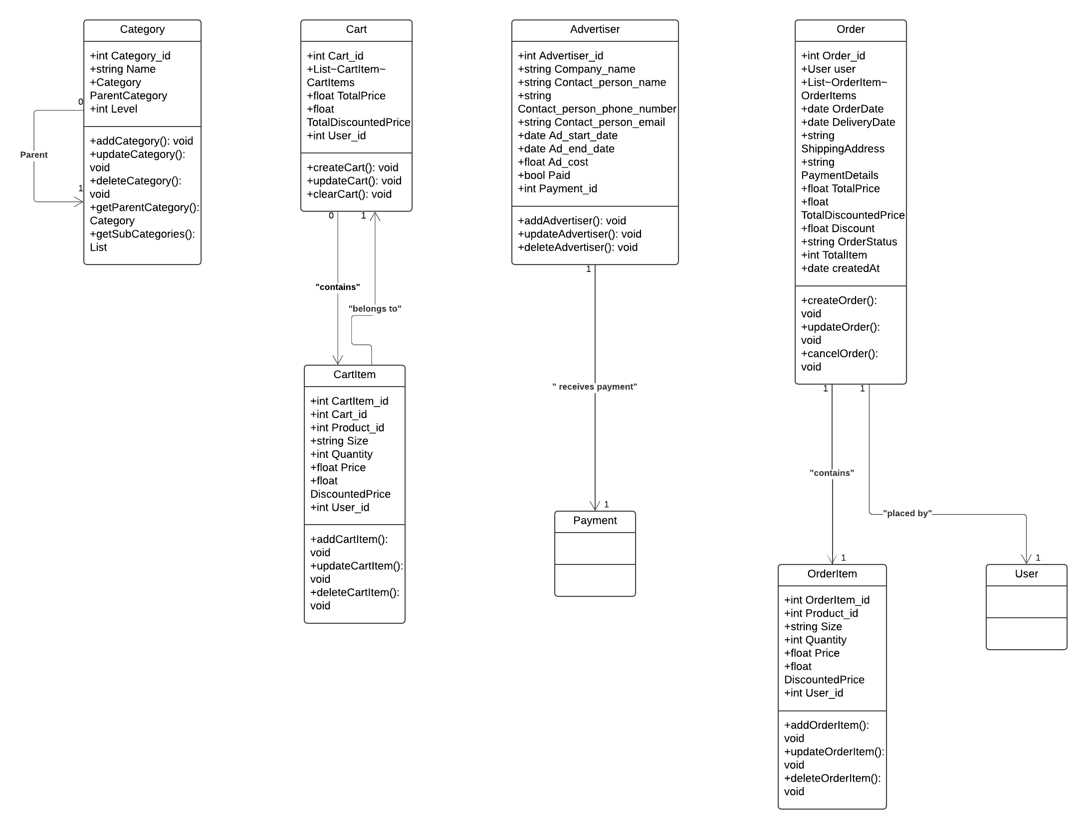
Class Diagram – Stylehive –S3

Slide 3
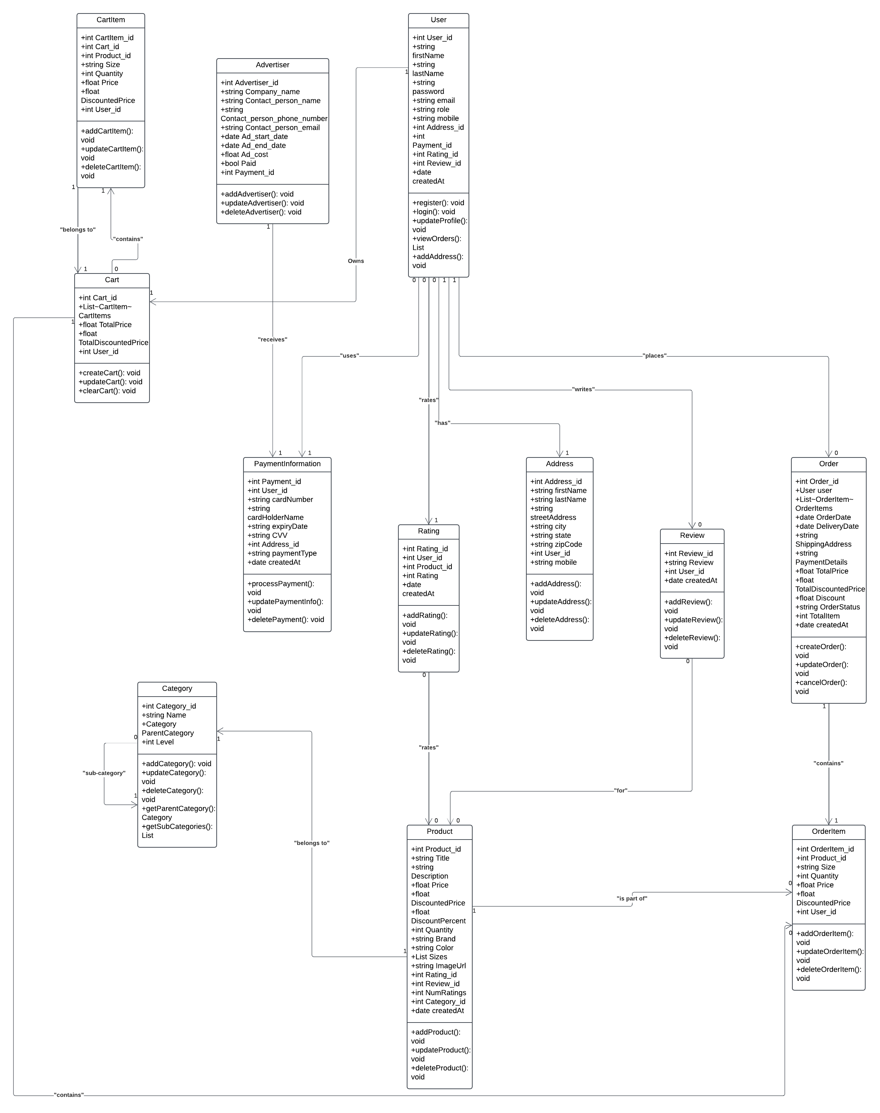
Final Class Diagram

